Slide 1

ASSESSMENT AND PROPOSED PLAN FOR AIS DATA CHALLENGE
MARY SCOTT, HIRA KHAN, LAMA ELNAGGER, ZAINA KAHIEL
TEAM 2173

Slide 2



Data Architecture strategy
Integrate with environmental data
Integrate with environmental data
Features
Dropdown menu
Output into a database that can be accessed with people with permission
Raw

Slide 3

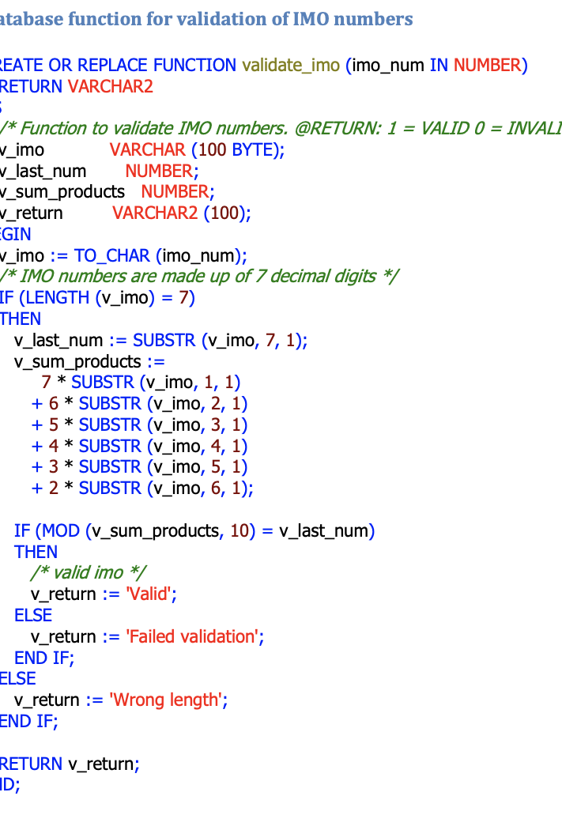

VESSEL INFORMATION VERIFICATION SYSTEM
IMO # validation algorithm (IMO 7-digits)
Digits weighted from right to left by 2,3,5,6,7
Add products
Divide sum by 10
Remainder is the check digit
You can add this algorithm to the code for the decoding procedure
MMSI validation algorithm
DaMSA reference table
Lloyd tables
Online ITU Maritime database
Missing data validation algorithm
Missing dynamic AIS data → interpolating techniques
Missing static AIS data → Exclude missing values
Compare missing vessel information to existing information within the data to interpolate and make an estimation

Slide 4
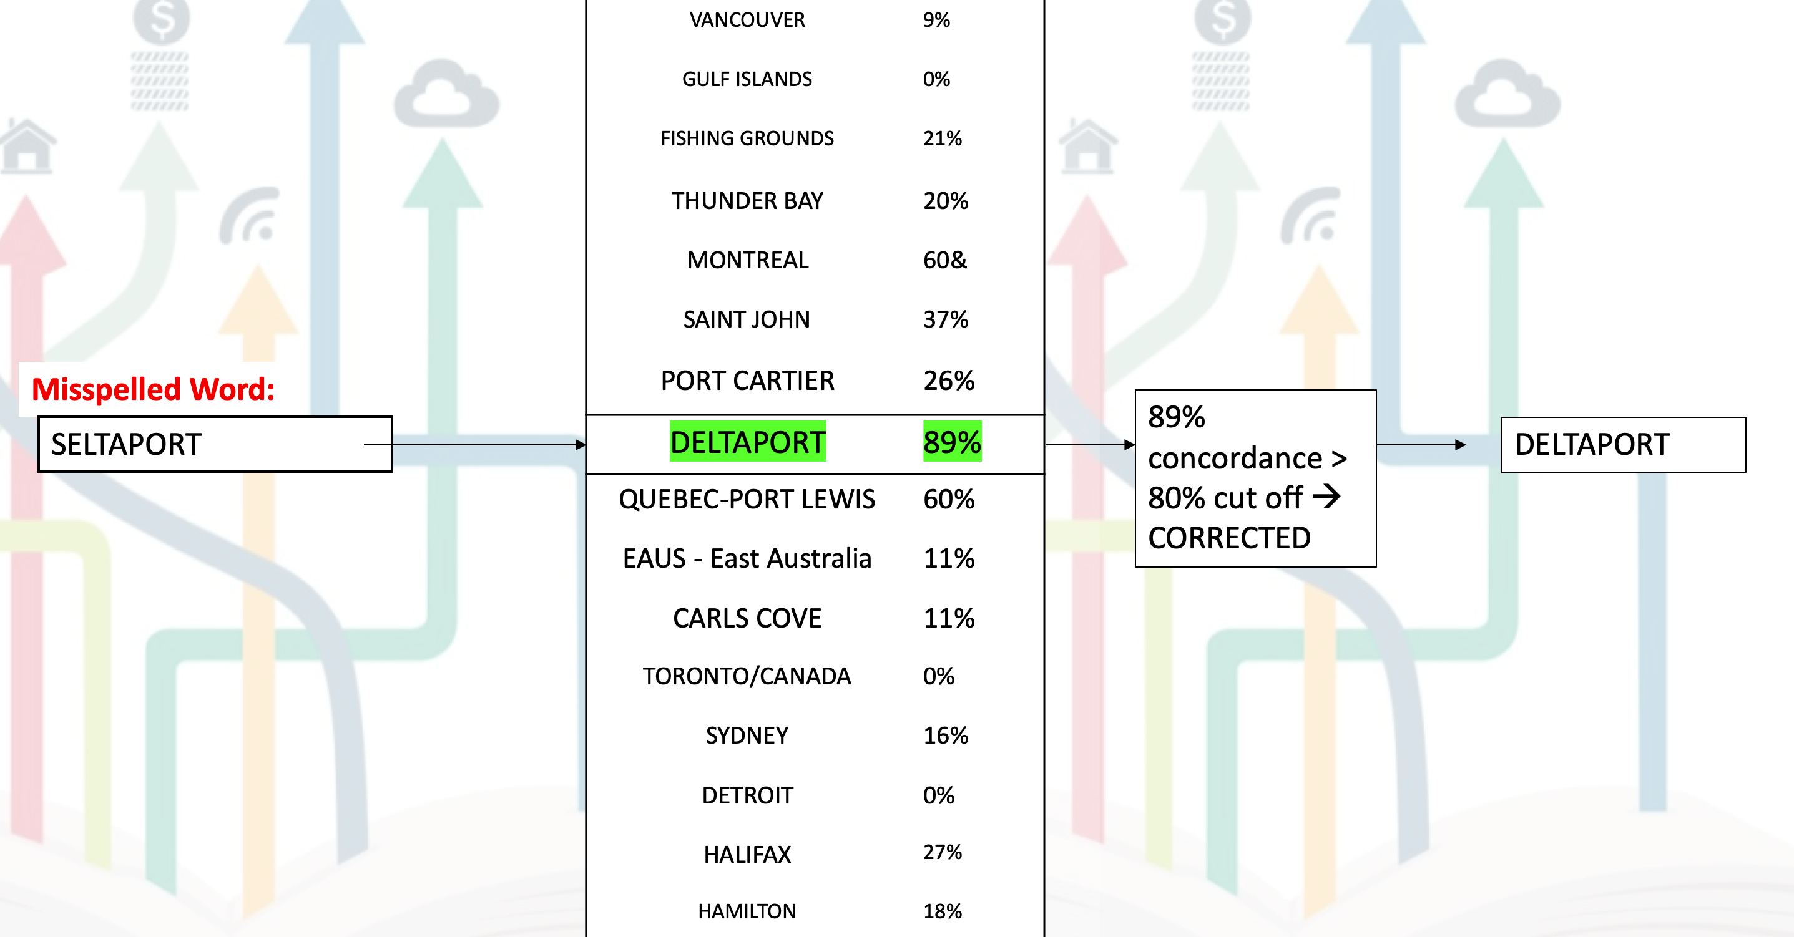
Dealing with spelling errors
Percent Concordance Strategy
Rules:
<4 words → 75% concordance
>5 words → 80% concordance
Linked to a dictionary of destinations

Slide 5

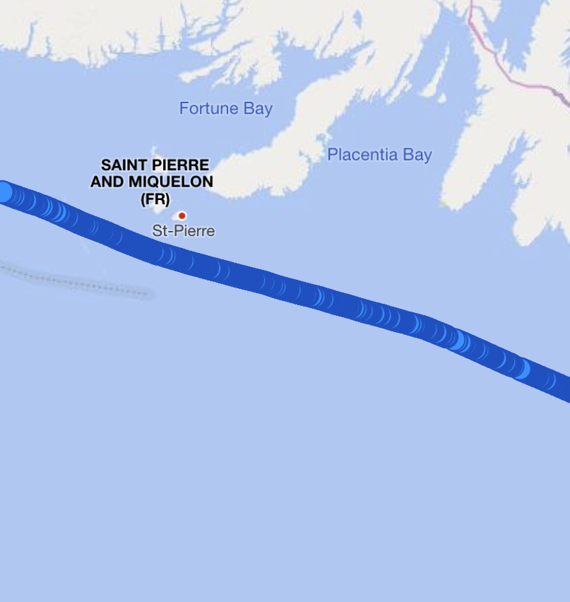
Tracking individual ships
Link

